Slide 1

Sonic
Video analysis using Lex to find Predator Intent

Slide 2
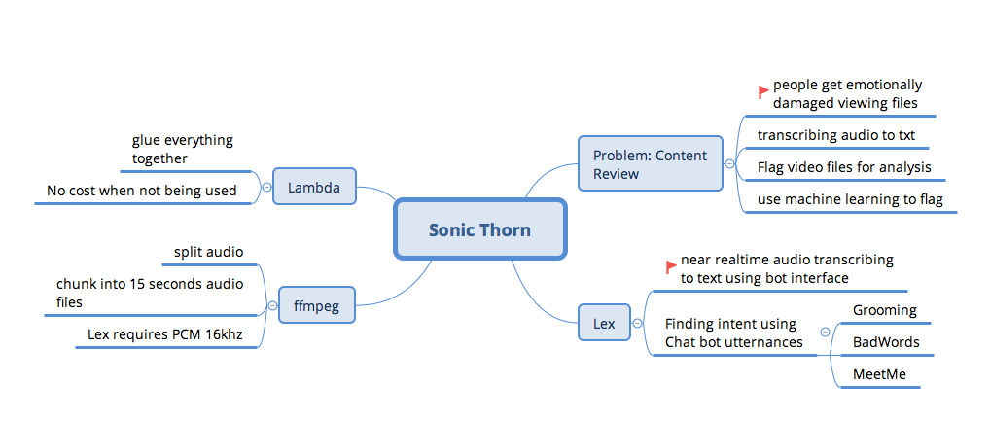
Problem: Video Analysis, people get emotionally damaged

Slide 3
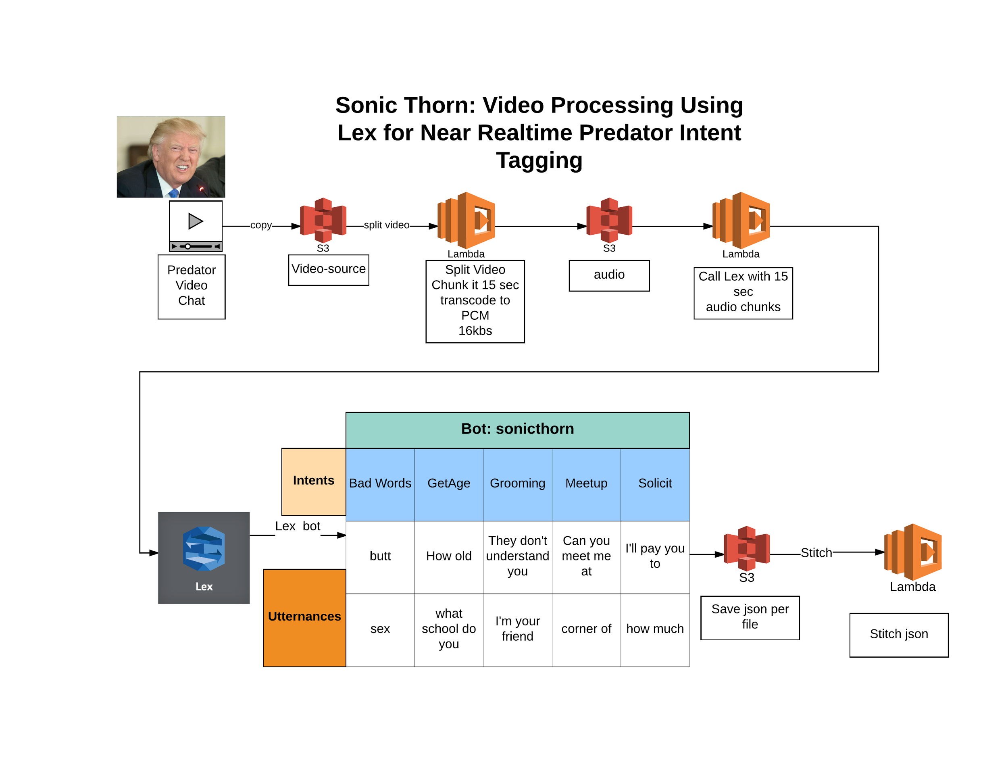

Slide 4
Basic Flow
Upload video
Split audio and video
Convert audio to PCM 16
Split into 15 second audio files for Lex
Send to Lex for transcribing and finding Intent
Stitch it all back together

Slide 5
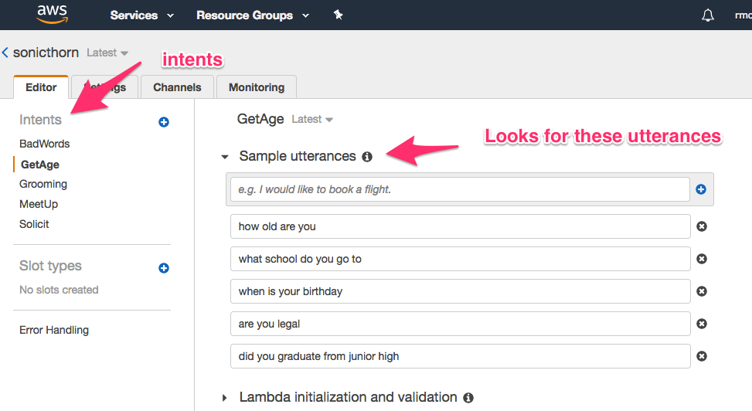
Lex Bots

Slide 6
Lex
aws lex-runtime post-content --region us-east-1 --bot-name sonicthorn --bot-alias "\$LATEST" --user-id UserOne --content-type "audio/l16; rate=16000; channels=1" --accept "text/plain; charset=utf-8" --input-stream predator-01.wav IntentOutputSpeech.mpg
Returns: { "contentType": "text/plain;charset=utf-8", "intentName": "Solicit", "slots": {}, "dialogState": "ReadyForFulfillment", "inputTranscript": "how much do you charge" }

Slide 7
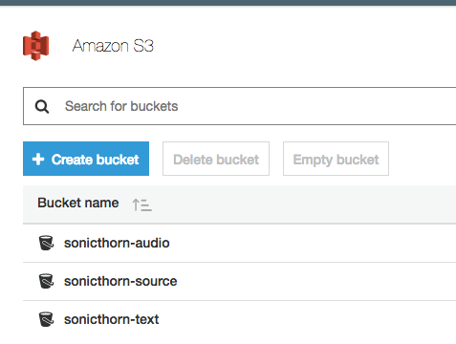
S3 buckets
https://s3.console.aws.amazon.com/s3/home?region=us-east-1

Slide 8
Results
file:////Users/roberto/projects/sonic_thorn/results.mp3

Slide 9
Team
Jack jzbruno@gmail.com
Roberto rmonge4surf@gmail.com
Josh josh.andrew.phillips@gmail.com
Jessica jessica.j.major@gmail.com
Chris zonk1024@gmail.com
Repo: https://github.com/redstonemercury/sonic-thorn
Google doc : https://docs.google.com/document/d/1MKHSdfErPp5-wEUSOOO3g9WsQIteJBWB1WhdfuaqU0w/edit?userstoinvite=joshua.andrew.phillips@gmail.com&ts=5a1c5eac&actionButton=1#

